Slide 1
SUPERSTORE DASHBOARD

Slide 2
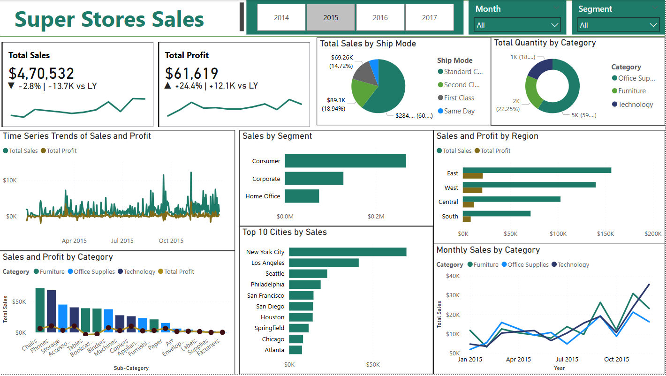

Slide 3
Objective
The goal of this interactive Power BI dashboard is to provide business stakeholders with comprehensive insights into the sales performance, profit trends, customer segments, and shipping efficiency of a retail superstore, enabling data-driven decisions to improve profitability and operational performance.

Slide 4
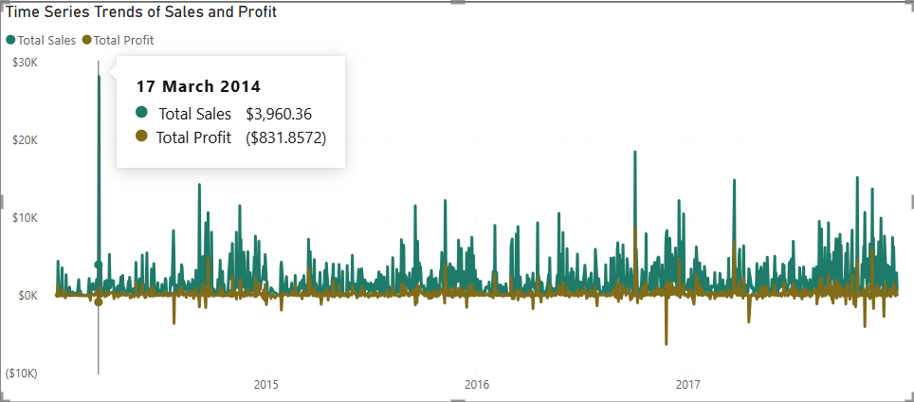
Time-Series Trends of Sales and Profit
Line chart tracks daily or monthly fluctuations in both sales and profit.
Identifies seasonal patterns, sales spikes, and periods of loss.

Slide 5
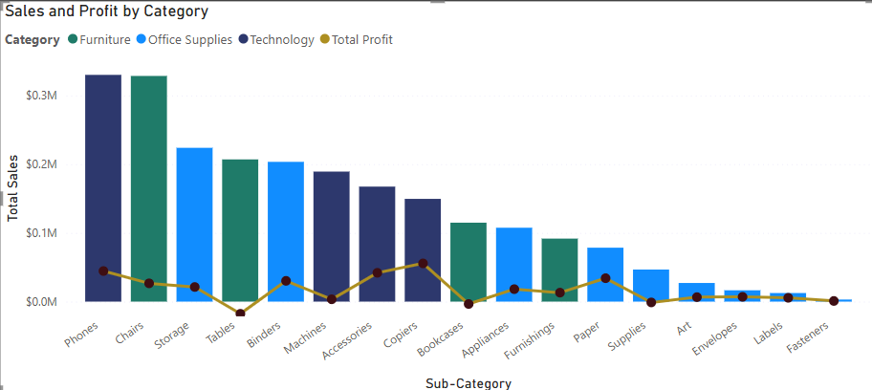
Sales and Profit by Category & Sub-Category
Bar chart with a line overlay gives clarity on: Top-performing sub-categories (e.g., Phones, Chairs).Loss-making categories (e.g., Tables). Helps identify which product categories need promotion or cost control.
Top 2 Most Profitable Sub-Categories- Copiers($55,618), Phones($44,516)
Bottom 5 (Loss-Making) Sub-Categories- Bookcases(- $3,473), Supplies(- $1,189)
Observation: Tables and Bookcases are generating losses and may need pricing or strategy review.

Slide 6
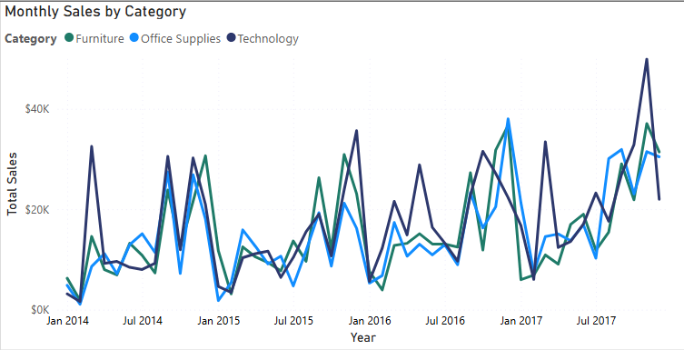
Monthly Sales by Category
Line chart compares monthly sales across Furniture, Technology, and Office Supplies.
Useful to spot trends and seasonality in category-wise performance.

Slide 7
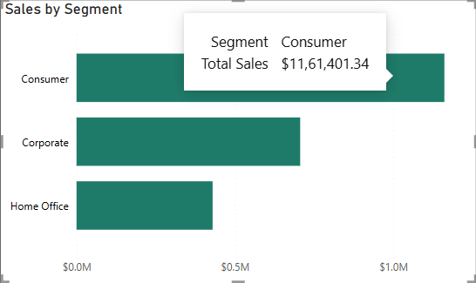
Sales by Segment
Segments: Consumer, Corporate, Home Office. Helps understand which segment is most profitable. Shows that Consumer is the most revenue-generating segment.

Slide 8
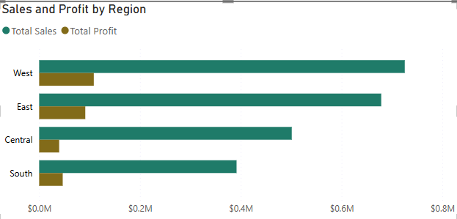
Sales and Profit by Region
Bar chart shows comparison across East, West, Central, and South regions. Combines both sales and profit to assess true performance. Example Insight: West performs best in both sales and profit.

Slide 9
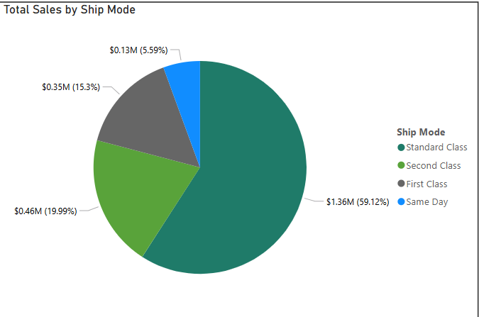
Sales by Ship Mode
Pie chart shows the distribution of sales by shipping type.
Standard Class dominates but with slower delivery, while Same Day is fast but less used.

Slide 10
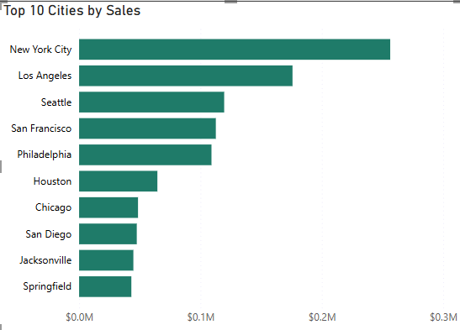
Top 10 Cities by Sales
Horizontal bar chart highlights top-performing cities like New York, Los Angeles, and Seattle.
Offers geographic insights for marketing and logistics planning.

Slide 11
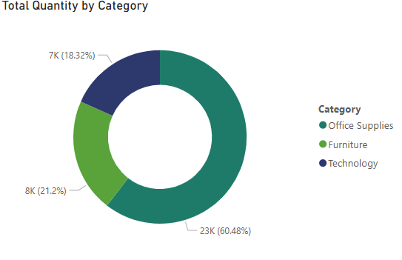
Total Quantity by Category
Donut chart displays sales volume distribution by category.
Reinforces which product types are sold the most (Office Supplies leads).

Slide 12
Insights Summary
1. Technology and Office Supplies are highly profitable and consistently growing.
2. Tables and Bookcases are underperforming in terms of profitability.
3. West and East regions lead in sales, while South has the most potential for growth.
4. Standard Shipping is most used but not the fastest — opportunity to promote faster modes.
5. Consumer Segment yields the highest revenue — ideal for targeted campaigns.

Slide 13
THANK YOU

